Slide 1

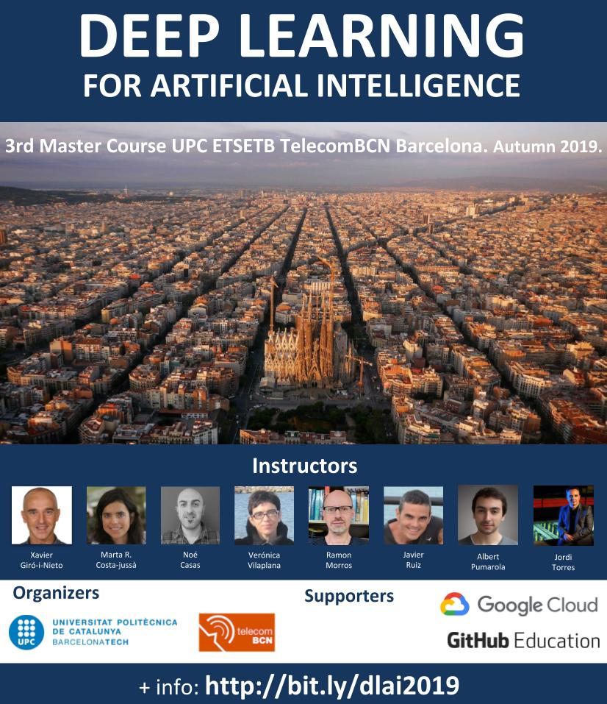



#DLUPC
Day 2 Lecture 2
Backpropagation
Xavier Giro-i-Nieto
xavier.giro@upc.edu
Associate Professor
Universitat Politècnica de Catalunya
Technical University of Catalonia
[course site]

Slide 2




Acknowledgements
Kevin McGuinness
kevin.mcguinness@dcu.ie
Research Fellow
Insight Centre for Data Analytics
Dublin City University
Elisa Sayrol
elisa.sayrol@upc.edu
Associate Professor
ETSETB TelecomBCN
Universitat Politècnica de Catalunya

Slide 3
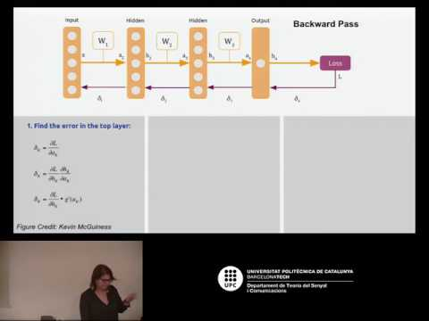
Video lecture

Slide 4

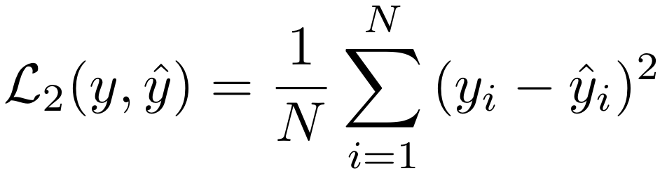
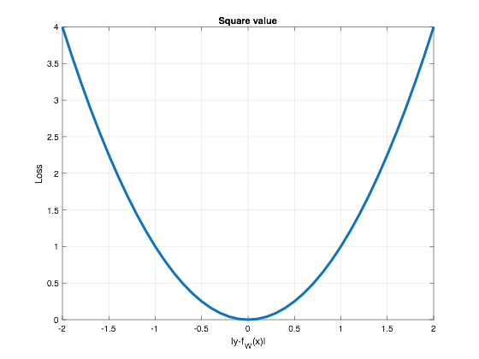
Loss function - L(y, ŷ)
The loss function assesses the performance of our model by comparing its predictions (y) to an expected value (ŷ), typically coming from ground truth labels.
Example: the predicted price (y) and one actually paid (ŷ) could be compared with the Euclidean distance (also referred as L2 distance or Mean Square Error - MSE):
1
x₁
b
w₁
x₂
y = {-∞, ∞}
w₂
x₃
w₃

Slide 5
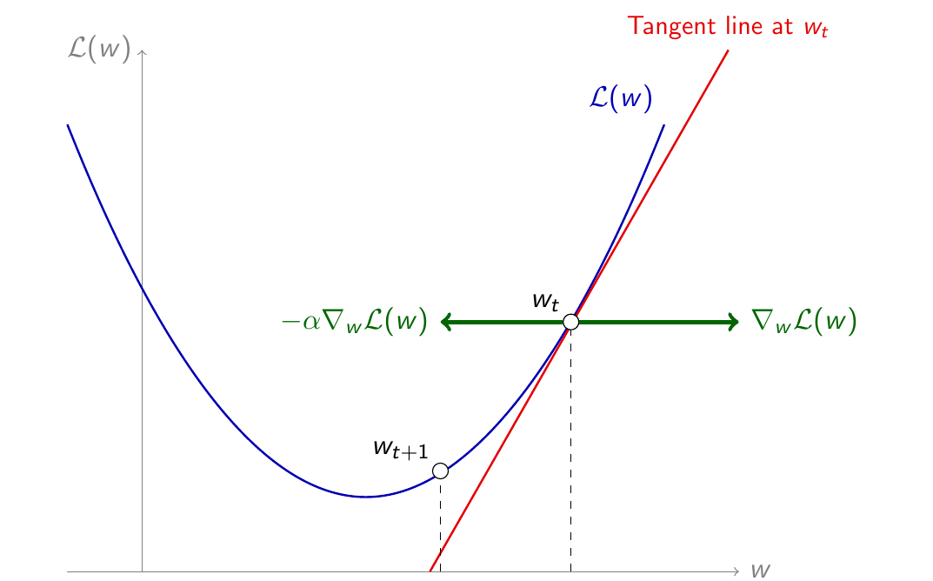
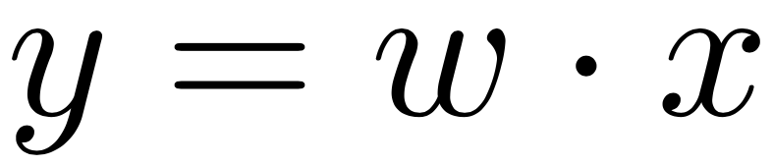
Loss function - L(y, ŷ)
Discussion: Consider the very simple model...
…....and that, given a pair (y, ŷ), we would like to update the current w_{t} value to a new w_{t+1} based on the loss function L_{w}.
Would you increase or decrease w_{t} ?
What operation could indicate which way to go ?
How much would you increase or decrease w_{t} ?
L_{w}

Slide 6
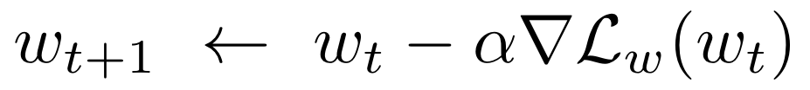
Gradient Descent (GD)
Motivation for this lecture:
if we had a way to compute the gradient of the loss with respect to the parameter(s), we could use gradient descent to optimize them.
L_{w}
Descend
(minus sign)
Learning
rate (LR)
Notes:
Canvia la W o la W1

Slide 7
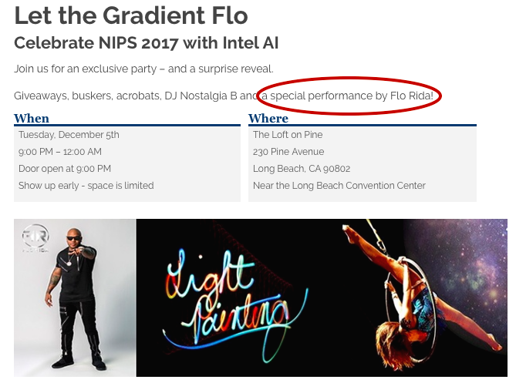
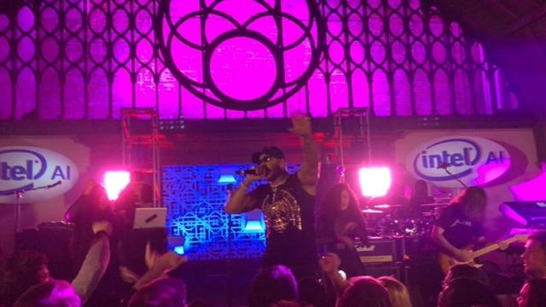
Gradient Descent (GD)
Backpropagation will allow us to compute the gradients of the loss function with respect to:
all model parameters (w) - final goal during training
input/intermediate data - visualization & interpretability purposes.
Gradients will “flow” from the output of the model towards the input (“back”).

Slide 8
Computational graph of a simple perceptron
1
b
Question: What is the computational graph (operations & order) of this perceptron with a sigmoid activation ?
σ
y = {0, 1}
x₁
w₁
x₂
w₂

Slide 9
Computational graph of a perceptron
w₁
1
x
x₁
b
w₂
σ
y = {0, 1}
x₁
w₁
x
x₂
x₂
w₂
Example adapted from “CS231n: Convolutional Neural Networks for Visual Recognition”, Stanford University.

Slide 10
Computational graph of a perceptron
w₁
1
x
x₁
b
+
w₂
σ
y = {0, 1}
x₁
w₁
x
x₂
x₂
w₂
Example adapted from “CS231n: Convolutional Neural Networks for Visual Recognition”, Stanford University.

Slide 11
Computational graph of a perceptron
w₁
1
x
x₁
b
+
+
w₂
σ
y = {0, 1}
x₁
w₁
x
x₂
x₂
w₂
b
Example adapted from “CS231n: Convolutional Neural Networks for Visual Recognition”, Stanford University.

Slide 12
Computational graph of a perceptron
w₁
1
x
x₁
y
b
+
+
σ
w₂
σ
y = {0, 1}
x₁
w₁
x
x₂
x₂
w₂
b
Example adapted from “CS231n: Convolutional Neural Networks for Visual Recognition”, Stanford University.

Slide 13

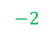
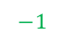

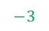

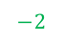
Computational graph of a perceptron
w₁
1
x
x₁
1
0.73
y
b
+
+
σ
w₂
σ
y = {0, 1}
x₁
w₁
x
x₂
x₂
w₂
b
Forward pass

Slide 14
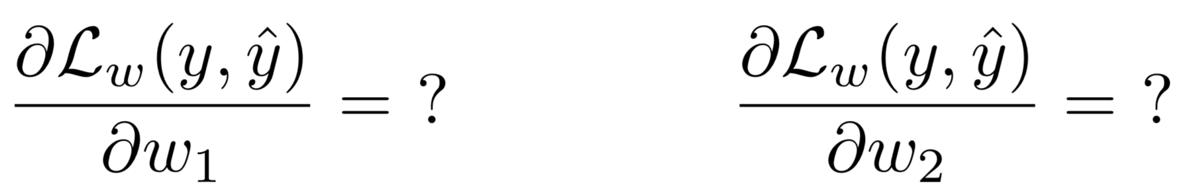
Computational graph of a perceptron
Challenge: How to compute the gradient of the loss function with respect to w₁ or w₂ ?
w₁
x
x₁
+
+
σ
y
w₂
x
x₂
ŷ
b

Slide 15
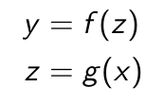
Gradients from composition (chain rule)
g(·)
f(·)
x
z
y
Forward pass

Slide 16
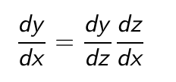
Gradients from composition (chain rule)
g(·)
f(·)
x
z
y
How does a variation (“difference”) on x affect y ?
?
Backward pass

Slide 17
Gradients from composition (chain rule)
g(·)
f(·)
x
z
y
How does a variation (“difference”) on x affect y ?
It will depend on the how y is affected by a variation in z...
Backward pass

Slide 18
Gradients from composition (chain rule)
g(·)
f(·)
x
z
y
How does a variation (“difference”) on x affect y ?
It will depend on the how y is affected by a variation in z...
...scaled (multiplied) by how z is affected with a variation in x.

Slide 19
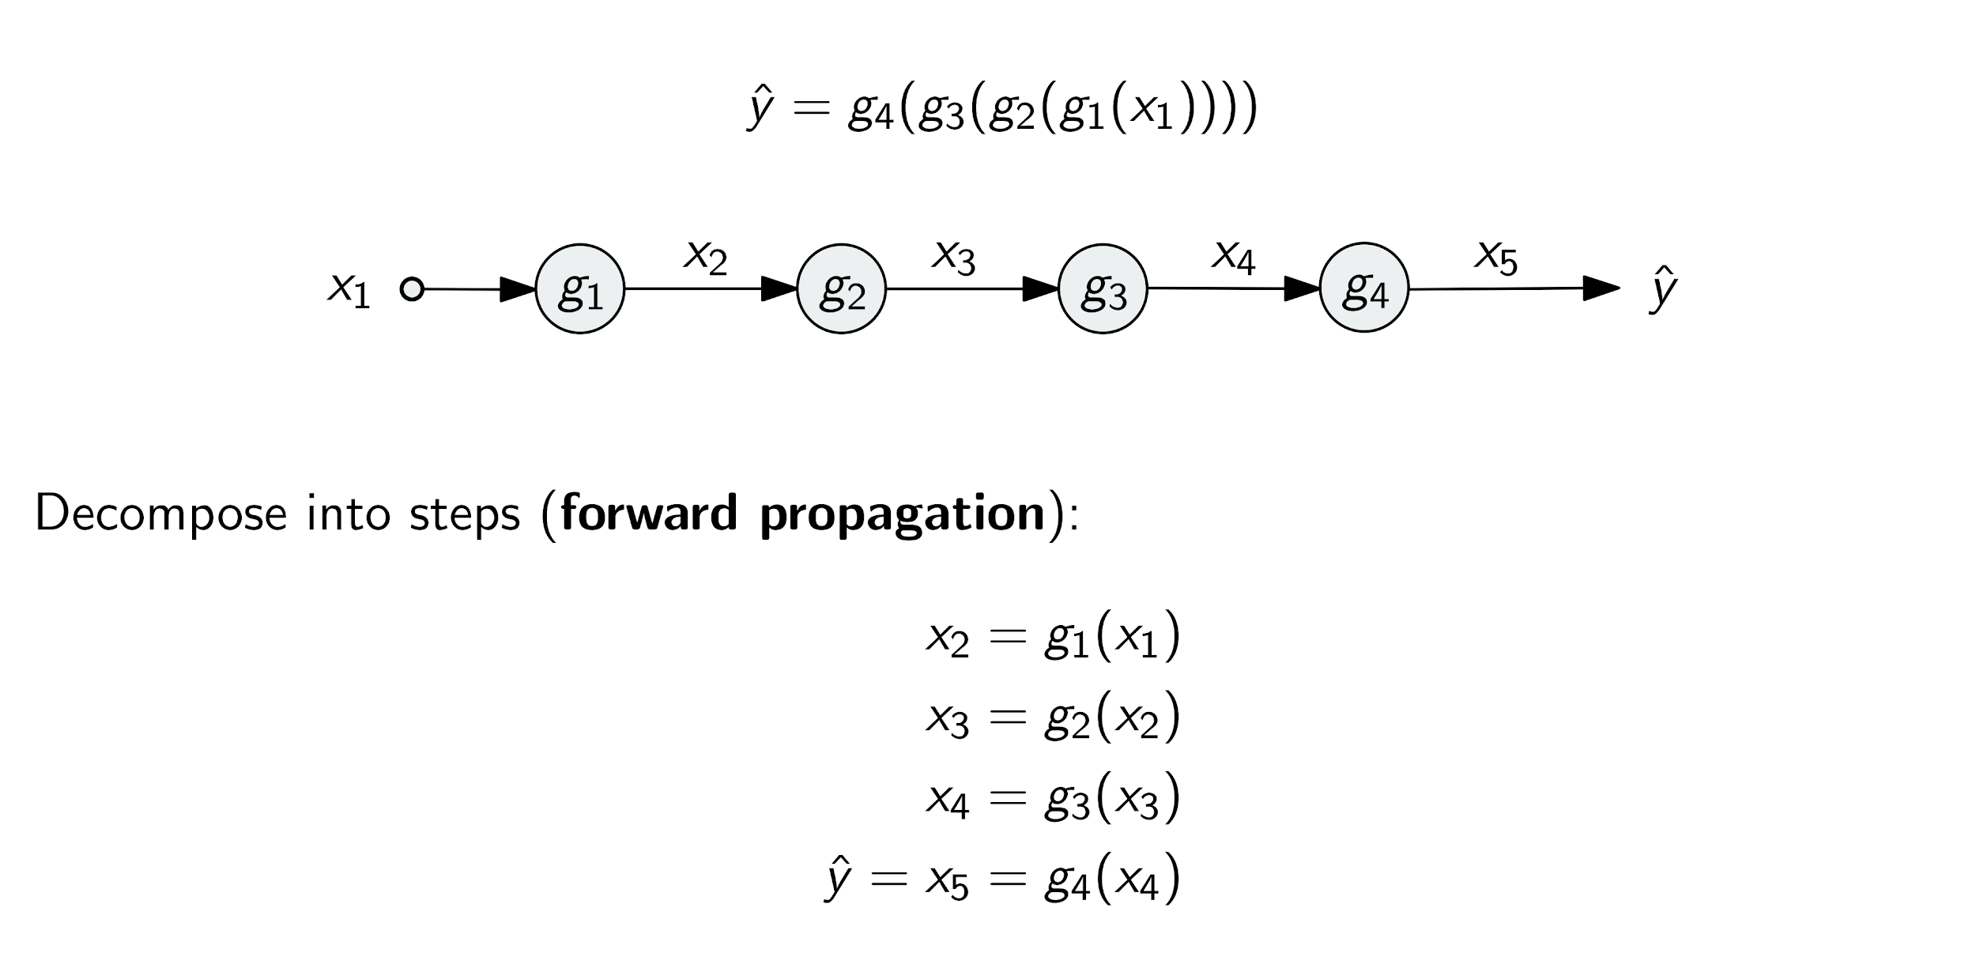
Gradients from composition (chain rule)
Forward pass

Slide 20
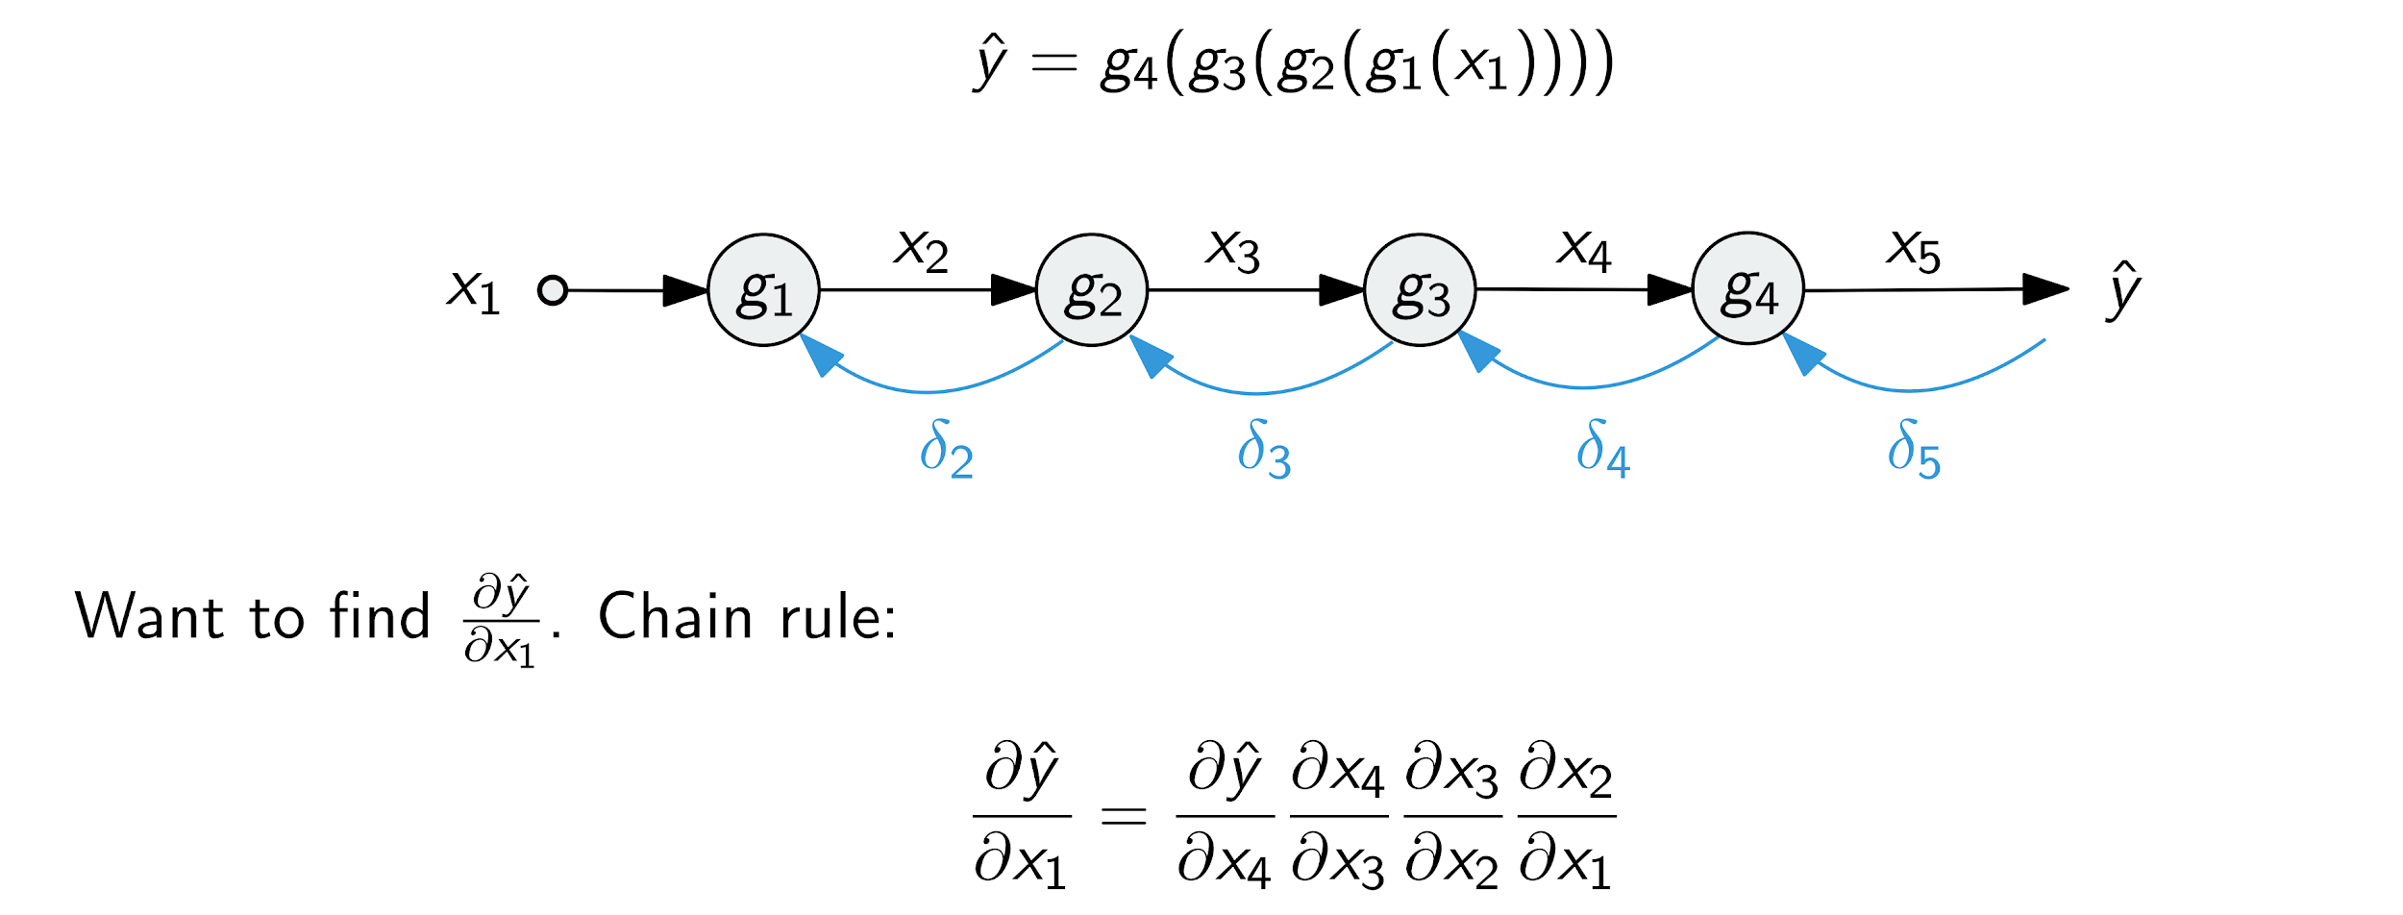
Gradients from composition (chain rule)
How does a variation (“difference”) on the input affect the prediction ?
Backward pass

Slide 21
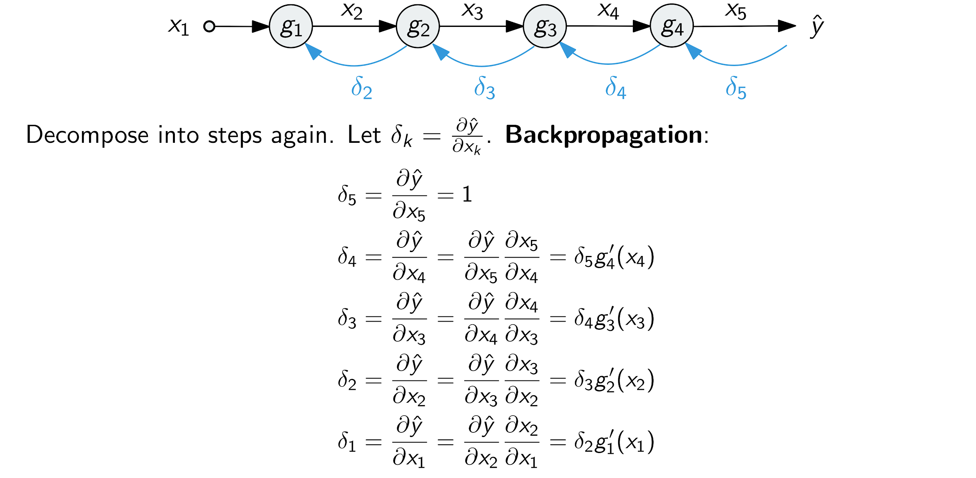
Gradients from composition (chain rule)
Backward pass

Slide 22
Gradients from composition (chain rule)
Question: How can gradients be backpropagated for the operations involved in a perceptron ?
PRODUCT (x)
SUM (+)
SIGMOID (σ)
w₁
x
x₁
y
+
+
σ
w₂
x
x₂
b

Slide 23
Gradient backpropagation in a perceptron
We can now estimate the sensitivity of the output y with respect to each input parameter w_{i} and x_{i}.
w₁
x
x₁
1
0.73
y
+
+
σ
w₂
dy/dy=1
x
x₂
b
Backward pass
Example extracted from Andrej Karpathy’s notes for CS231n from Stanford University.

Slide 24
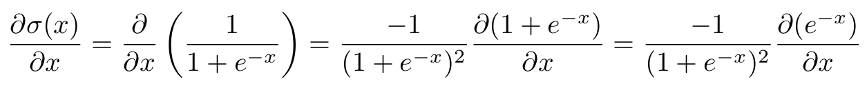
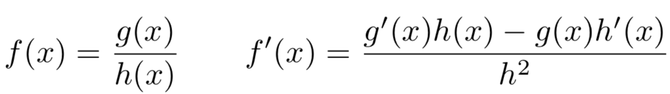
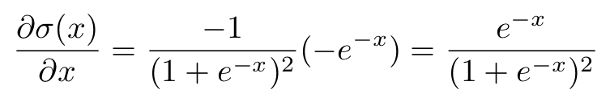
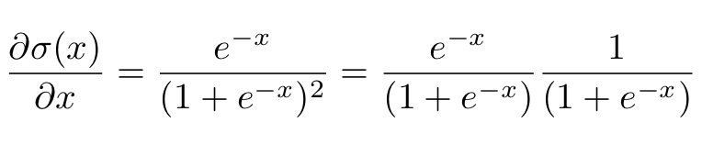
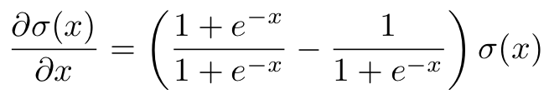
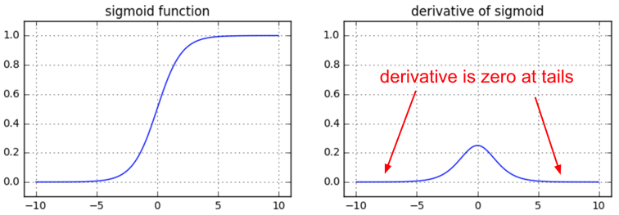
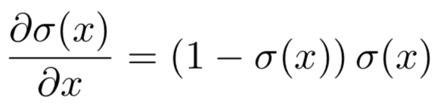
Gradient weights for sigmoid σ
(*)
(*)
w₁
x
...which can be re-arranged as...
x₁
y
+
+
σ
w₂
x
x₂
b
Even more details: Arunava, “Derivative of the Sigmoid function” (2018)
Figure: Andrej Karpathy

Slide 25
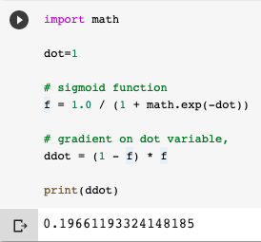
Gradient backpropagation in a perceptron
w₁
x
x₁
1
0.73
y
+
+
σ
w₂
0,2
dy/dy=1
x
x₂
b
Backward pass
Example extracted from Andrej Karpathy’s notes for CS231n from Stanford University.

Slide 26
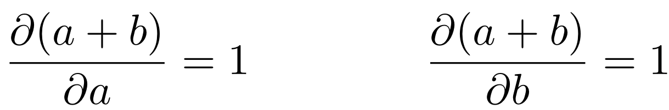
Gradient backpropagation in a perceptron
Sum: Distributes the gradient to both branches.
w₁
x
x₁
0,2
1
0.73
y
+
+
σ
0,2
0,2
dy/dy=1
w₂
x
0,2
x₂
b
Backward pass
dy/db
0,2
Example extracted from Andrej Karpathy’s notes for CS231n from Stanford University.

Slide 27
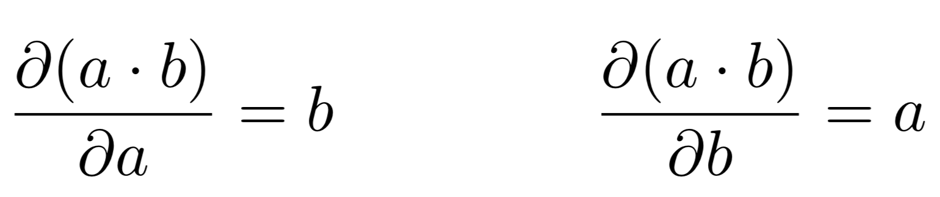
Gradient backpropagation in a perceptron
Product: Switches gradient weight values.
w₁
dy/dw₁
-0,2
x
x₁
0,2
1
0.73
y
dy/dx₁
0,4
+
+
σ
0,2
0,2
dy/dy=1
w₂
dy/dw₂
-0,4
x
0,2
x₂
dy/dx₂
-0,6
b
Backward pass
dy/db
0,2
Example extracted from Andrej Karpathy’s notes for CS231n from Stanford University.

Slide 28
Gradient backpropagation in a perceptron
Normally, we will be interested only on the weights (w_{i}) and biases (b), not the inputs (x_{i}). The weights are the parameters to learn in our models.
w₁
dy/dw₁
-0,2
x
x₁
0,2
1
0.73
y
dy/dx₁
0,4
+
+
σ
0,2
0,2
dy/dy=1
w₂
dy/dw₂
-0,4
x
0,2
x₂
dy/dx₂
-0,6
b
Backward pass
dy/db
0,2
Example extracted from Andrej Karpathy’s notes for CS231n from Stanford University.

Slide 29
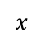


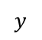
(bonus) Gradients weights for MAX & SPLIT
Max: Routes the gradient only to the higher input branch (not sensitive to the lower branches).
0,2
max
0,2
0
Split: Branches that split in the forward pass and merge in the backward pass, add gradients
+

Slide 30
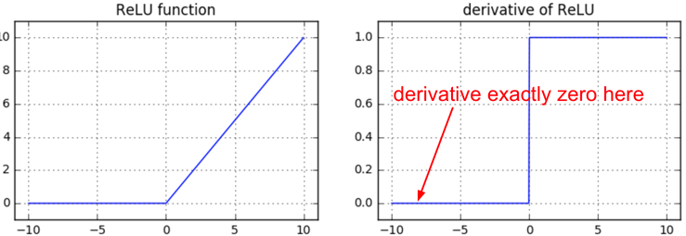
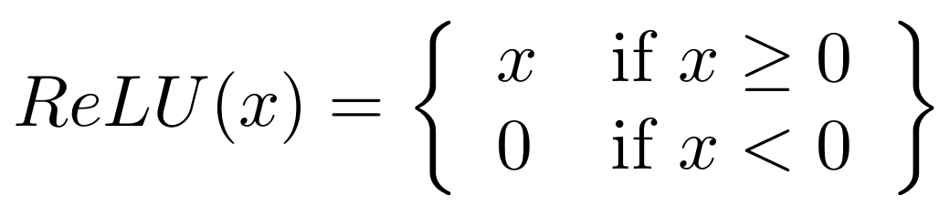
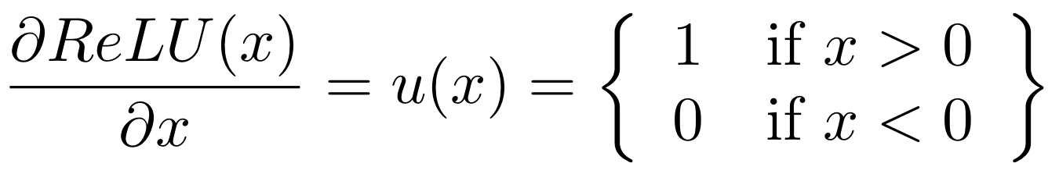
(bonus) Gradient weights for ReLU
Figures: Andrej Karpathy

Slide 31
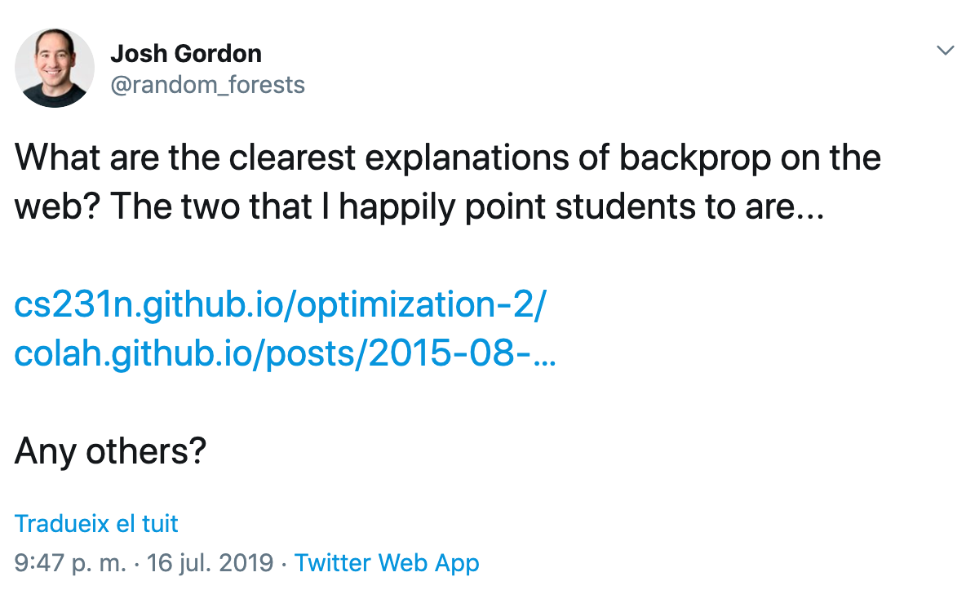
Learn more
READ
Chris Olah, “Calculus on Computational Graphs: Backpropagation” (2015).
Andrej Karpathy,, “Yes, you should understand backprop” (2016), and his “course notes at Stanford University CS231n.
WATCH
Gilbert Strang, “27. Backpropagation: Find Partial Derivatives”. MIT 18.065 (2018)
Notes:
Eliminar aquest recordatoei i posr l’exemple de càlcul de funció de pèrdues del capítol d’optimització per motivar l’objectiu.

Slide 32


